Slide 1
Fine-tune STT model
Guidance

Slide 2
Needed codes:
1)UOB_fine_tune_dataset_making.ipynb (open with Jupyter)
2)uob_dataloading.py
3)wer.py
4)UOB_Malaya-speech_fine-tune.ipynb (open with Jupyter)
Operating procedures:
Part 1: prepare fine-tuning dataset
Part 2: change the path in the 1)fine-tuning code and 2)dataloading script
Part 3: set the approximate parameters and get a fine-tuned model

Slide 3
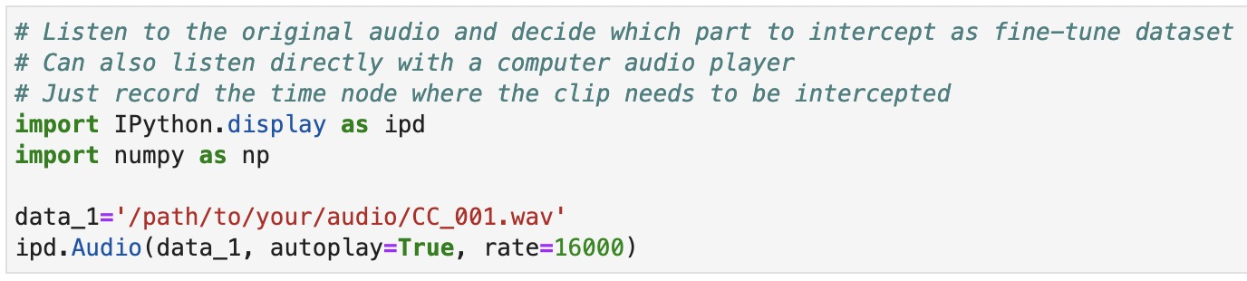
Part 1 prepare fine-tuning dataset
1) open the “UOB_fine_tune_dataset_making.ipynb” in Jupyter, use this part of code to play the audio and decide the part that can be used for fine-tuning.
here put the path to the original audio

Slide 4
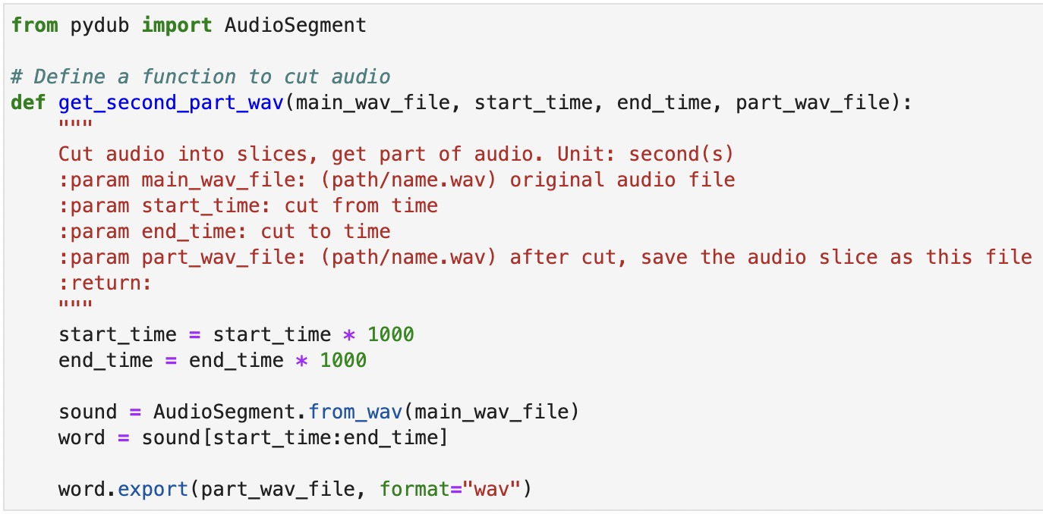
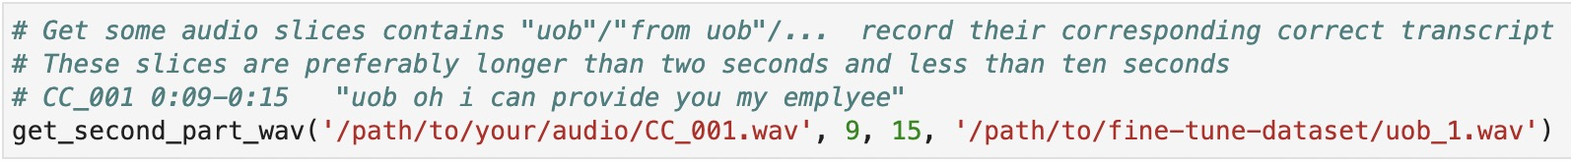
Part 1 prepare fine-tuning dataset
2) use this part of code to intercept audio slices that need to be used as fine-tuning datasets. Store in folder named “fine-tune-dataset”
folder to store the fine-tuning audio slices
name the audio slice

Slide 5
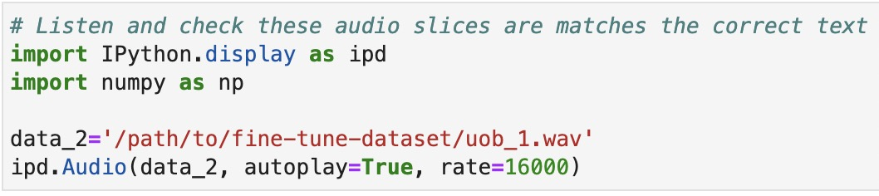
Part 1 prepare fine-tuning dataset
3) use this part of code preprocess all of the slices in the folder
Listen to whether the audio is cut correctly and is clear

Slide 6
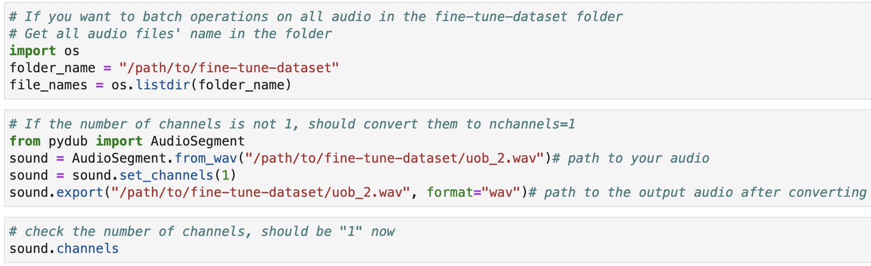
Part 1 prepare fine-tuning dataset
3) use this part of code preprocess all of the slices in the folder
If the audio is not mono, it needs to be converted to mono

Slide 7
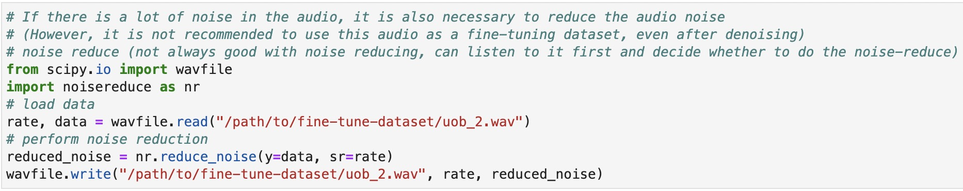
Part 1 prepare fine-tuning dataset
3) use this part of code preprocess all of the slices in the folder
Noise reduction is required if the audio is noticeably noisy

Slide 8
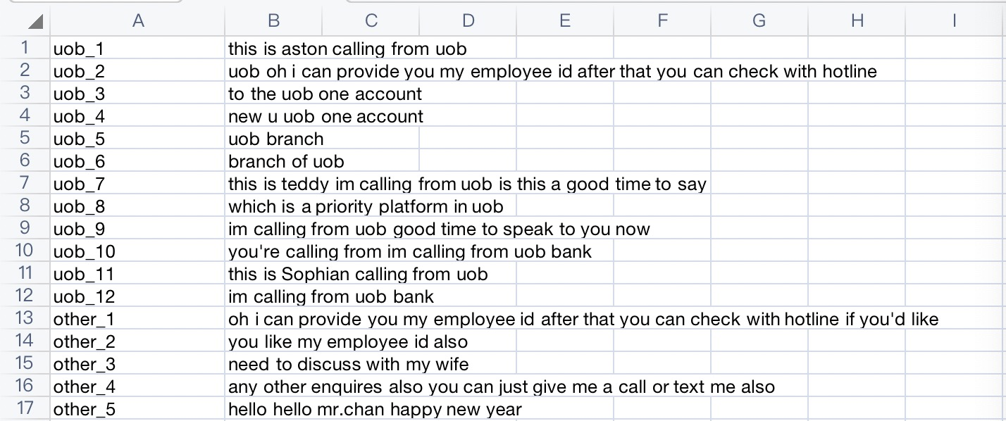
Part 1 prepare fine-tuning dataset
4) record the corresponding text in csv like this:
first column:
the name of the audio slices
second column:
correct text for each audio slice

Slide 9
Part 1 prepare fine-tuning dataset
5) divide those slices into training set and testing set
(if the data set is no more than 30 slices, set proportion around training:testing =9:1; If the data set is large, set proportion around training:testing =7:3)
Note:
In all the texts corresponding to the audio of the training set, the 26 English letters need to appear at least once, otherwise the fine-tuning model will report an error later (reason: the vocab_list generated based on the text needs to match the vocab_list of the original model)
The fine-tuning dataset shouldn't be too small, otherwise the generalization ability of the model will be poor

Slide 10
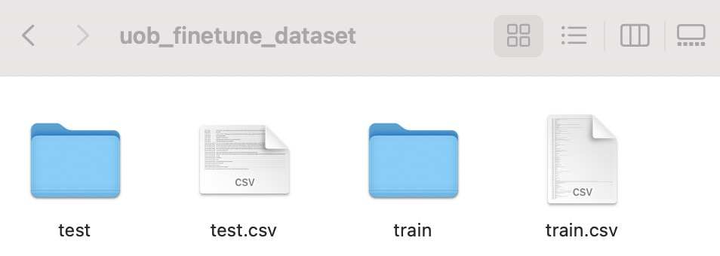
Part 1 prepare fine-tuning dataset
6)prepare a empty folder named “uob_finetune_dataset”, inside the folder put the training slices into folder named “train”, put the testing slices into folder named “test”, divide the transcript csv to train.csv and test.csv as well.

Slide 11
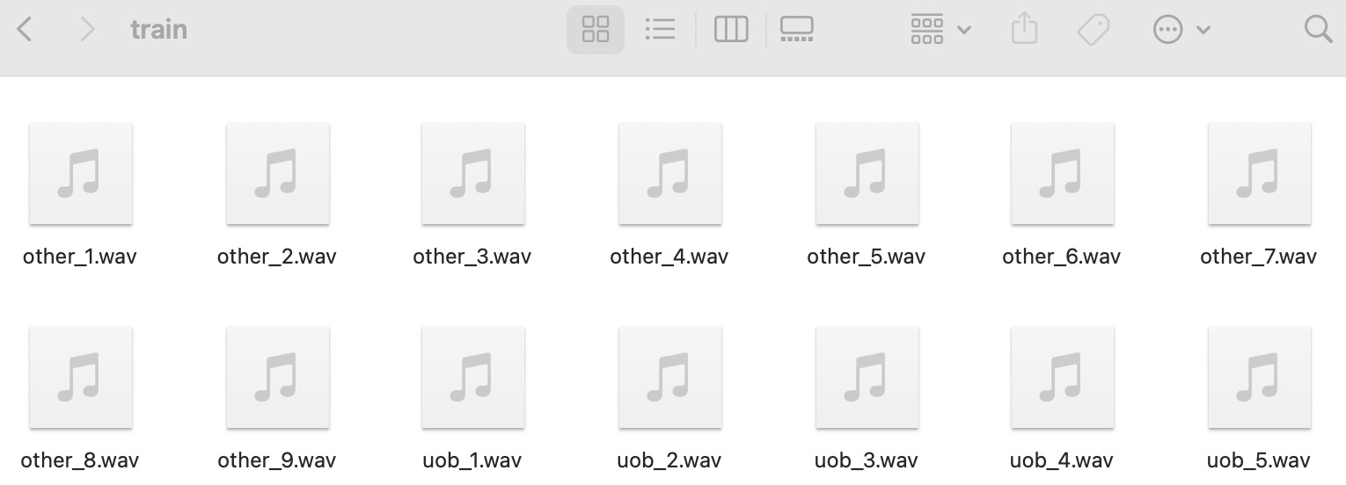
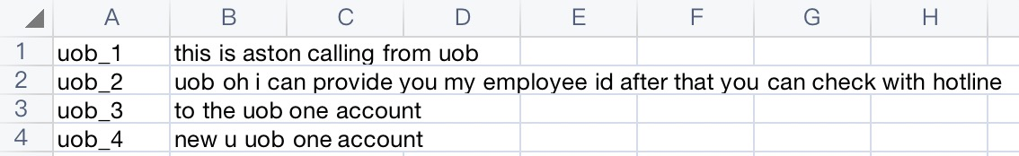
Part 1 prepare fine-tuning dataset
inside the train (test) folder
inside the train.csv (test.csv)
zip the “uob_finetune_dataset” folder
path to this zip file is “path/to/uob_finetune_dataset.zip”

Slide 12
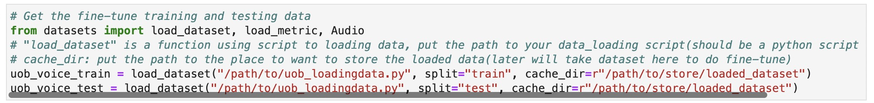
Part 2: change the path in the fine-tuning code and dataloading script
1) change the path in the fine-tuning code
open the “UOB_Malaya-speech_fine-tune.ipynb” in Jupyter
here put the path to get data loading
script (the file: uob_loadingdata.py)
here put the path to the folder you want to store the dataset that you get through data loading script
can also just set: cache_dir=r"./" to store dataset in the current directory

Slide 13
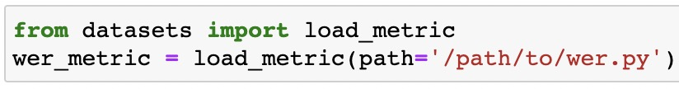
Part 2: change the path in the fine-tuning code and dataloading script
1) change the path in the fine-tuning code
The folder used to store files related to generating new models
can also just set: save_directory="./new_model_folder" to generate a folder in the current directory
Since we can't get the measurement method of wer (word error rate) online, we directly load the wer.py script file here.

Slide 14
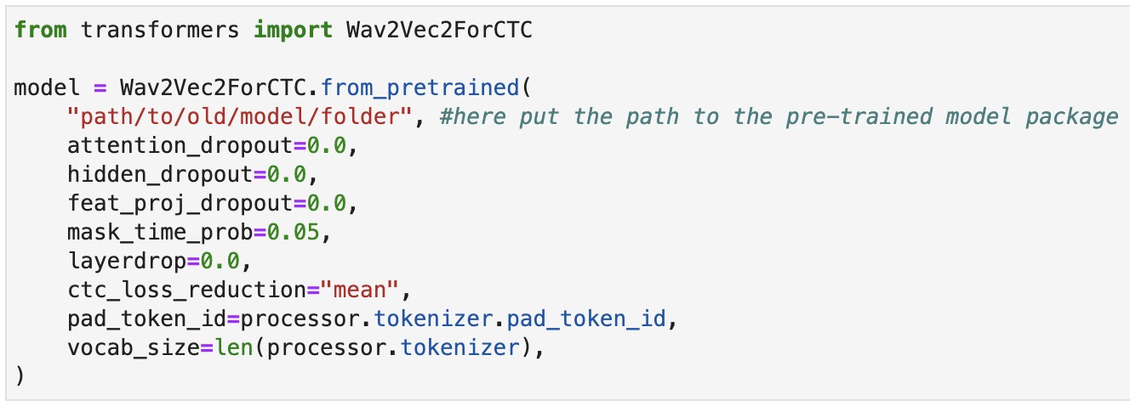
Part 2: change the path in the fine-tuning code and dataloading script
1) change the path in the fine-tuning code
here put the path to get the pre-trained model (the model we want to do fine-tuning on)
It should be a folder, inside the folder have six files: (1)pytorch_model.bin, (2)config.json, (3)preprocessor_config.json, (4)special_tokens_map.json, (5)vocab.json, (6)tokenizer_config.json

Slide 15
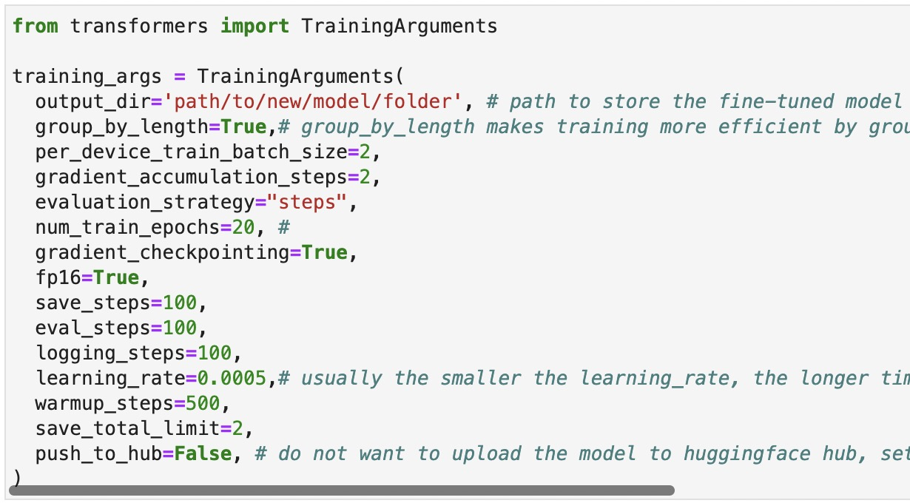
Part 2: change the path in the fine-tuning code and dataloading script
1) change the path in the fine-tuning code
here put the path to the folder you want to store the model after fine-tuning
can also just set: output_dir="./finetuned_model_name" to store the fine-tuned model in the current directory

Slide 16
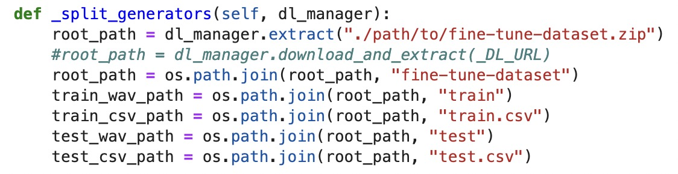
Part 2: change the path in the fine-tuning code and dataloading script
2)change the path in the dataloading script
open the “uob_dataloading.py”
here put the path to get the fine-tune data zip file (named: fine-tune-dataset.zip) we have prepared in Part 1
folder name after the zip file is unzipped, should be same with zip file name

Slide 17
Part 3: set the approximate parameters and get a fine-tuned model
1)Before running the fine-tuning code, install the needed python packages (if you haven't install):
(If can not use “pip install package-name” to download directly, here is the relatively time-saving method way to download in window's system.)
Please search these packages on PYPI and use wheel or packages to download it.
For package.whl file:
Put package.whl file in Anaconda3 -> Script packages and open Anaconda cmd here, run: pip install package.whl
For packages.zip conclude setup.py inside:
Unzip the packages.zip
Put the packages in Anaconda3 -> Lib -> site-packages and open Anaconda cmd in the package, run: python setup.py install

Slide 18
1)dataset == 1.18.3 Steps of installing datasets ==1.18.3: install pyarrow!=4.0.0,>=3.0.0 install dill install multiprocess install xxhash install tqdm install dataset
2)transformers==4.11.3
Steps of installing transformers==4.11.3:
Before installing transformers, these packages are needed to installed fisrt:
filelock, huggingface-hub, numpy, packaging, pyyaml, regex, requests, tokenizers, tqdm
3)torchaudio==0.10.0
Steps of installing torchaudio==0.10.0:
install torch == 0.10.0
install torchaudio
4)jiwer
Steps of installing jiwer:
install python-Levenshtein
install jiwer
5)pandas
6)numpy

Slide 19
Part 3: set the approximate parameters and get a fine-tuned model
2) required parameters recommendation
In the last section of "UOB_Malaya-speech_fine-tune.ipynb":
The meaning of each parameter in details can be found in:
https://huggingface.co/transformers/v3.5.1/main_classes/trainer.html#transformers.TrainingArguments

Slide 20
Part 3: set the approximate parameters and get a fine-tuned model
2) required parameters recommendation
Some suggestions for training parameter settings:
(1)If you set evaluation_strategy="steps", save_steps=100, eval_steps=100, the model will evaluate the effect of the model every 100 steps of training, and store the checkpoints after the model update every 100 steps, and the related files will exist in new/model/folder/checkpoint -100, new/model/folder/checkpoint-200... inside. If the amount of data in the training set is small, it is recommended to set eval_steps and save_steps to be small, such as eval_steps=10, otherwise the model may not have the result of the training process
(2)In general, the smaller the learning_rate setting, the more detailed the model will learn (the better the learning effect), but it is also more likely to cause overfitting, which affects the normal recognition of non-training data
It is recommended to set learning_rate to 0.0002 or 0.0005 or 0.0001

Slide 21
Part 3: set the approximate parameters and get a fine-tuned model
2) required parameters recommendation
Some suggestions for training parameter settings:
(3) per_device_train_batch_size: If the GPU capacity is not large enough, it is recommended to set this parameter to 2. If the GPU is relatively strong, it can be set to 4 or 8
(4) num_train_epochs: One epoch indicates that the model has been learned once based on all the data, and subsequent epochs will iteratively learn based on it. Since we are just fine-tune, not training a model from scratch, we generally set the num_train_epochs = 10 ～ 30. Too much will lead to overfitting of the model.
(5) warmup_steps: The number of training steps before starting to record the results of the training process, which can be set to 0. If the training set is large, you can set some warm-up steps

Slide 22
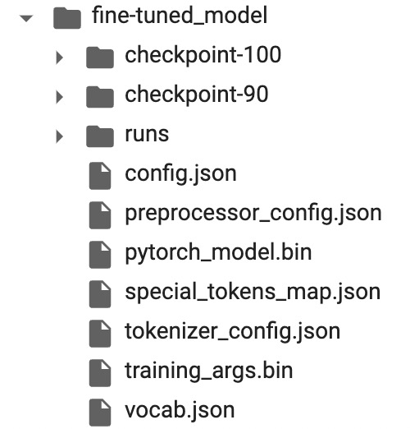
Part 3: set the approximate parameters and get a fine-tuned model
3) get a fine-tuned model
There will be these files in the new_model_folder at this time. The six circled files will be used to run the model later (other files are not used and can be deleted)

Slide 23
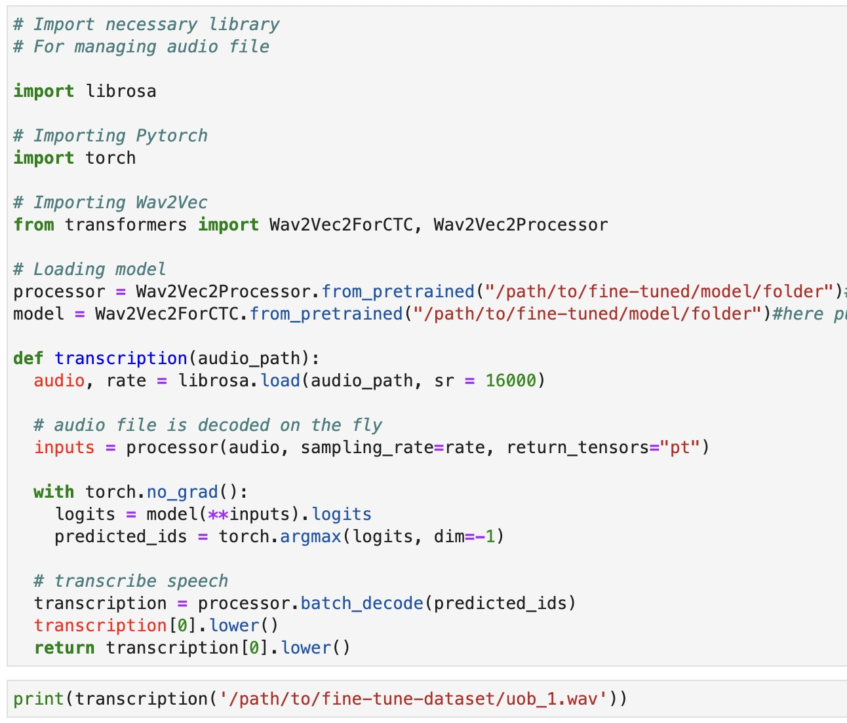
Use the fine-tuned model
Simple testing:
At the end of the "UOB_Malaya-speech_fine-tune.ipynb" file there is code for a simple test of the fine-tuned model
here put the path to the newly generated (fine-tuned) model folder (contains six files mentioned before)
here put the path to the testing audio (should be a small slice of audio, can use the testing set data directly), Check if the model can run successfully

Slide 24
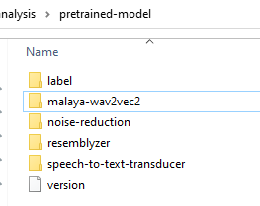
Use the fine-tuned model
Replace the old model with fine-tuned model:
In the whole system code, in the “pretrained-model” folder, replace the six files in the “malaya-wav2vec2” folder from old model's to new fine-tuned model's
Then can run the whole analysis system with the fine-tuned STT model
(Inside the fine-tuned model folder (malaya-wav2vec2) should include these six files: pytorch_model.bin, config.json, preprocessor_config.json, special_tokens_map.json, vocab.json, tokenizer_config.json)

